Slide 1


FARMART-FARMERSWEBAPP

Slide 2
TEAM NAME and MEMBER DETAILS
Akhilasree M (Team Leader) ,
Sri Ramakrishna Engineering College,Coimbatore
Bhagya Lakshmi T,
Sri Ramakrishna Engineering College, Coimbatore
THEME: FarmersWebApp

Slide 3
PROBLEM STATEMENT
Ensure that farmers get fair value for their product by providing better information about crop fairs and the appropriate buyers.

Slide 4
SOLUTION
Customers and farmers fill out basic information in the signup form to receive login credentials
Create a separate profile for each farmer and current customer after logging in
Customers can pay and purchase their products
Farmers have pages with crop details
Customer can choose the product according to the farmers
The farmers send the product so they can retrieve the product.

Slide 5
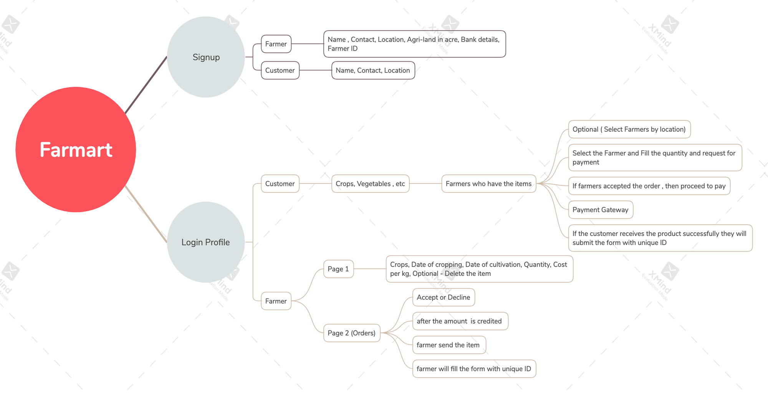
METHODOLOGY

Slide 6
WORKING PROTOTYPE
https://youtu.be/CcNR_jqpu90

Slide 7
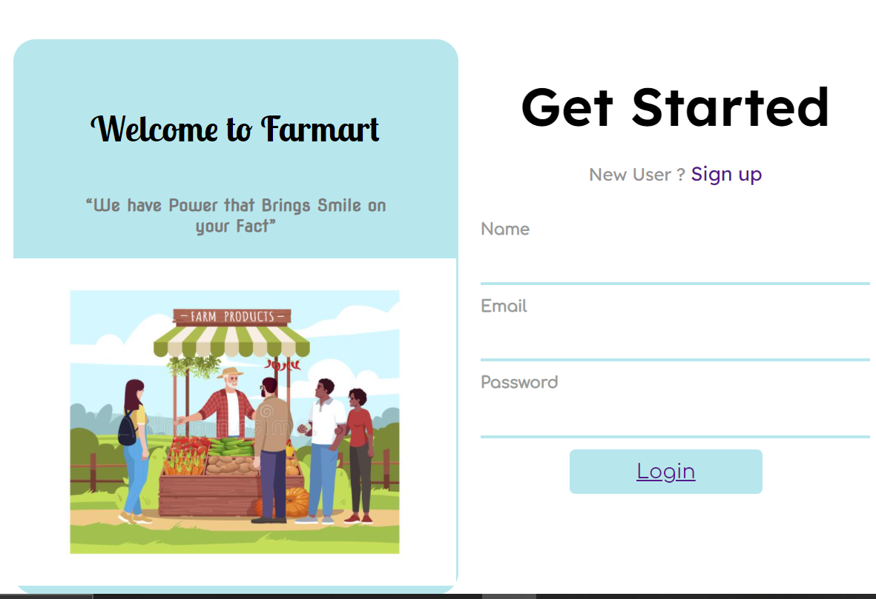
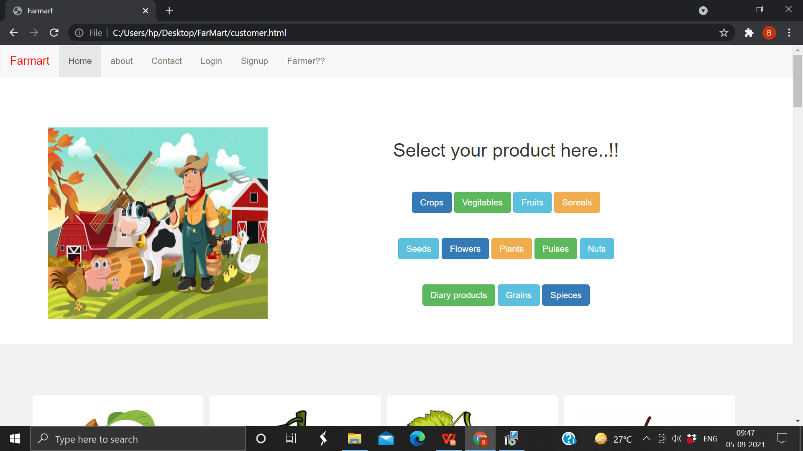
Attachments

Slide 8
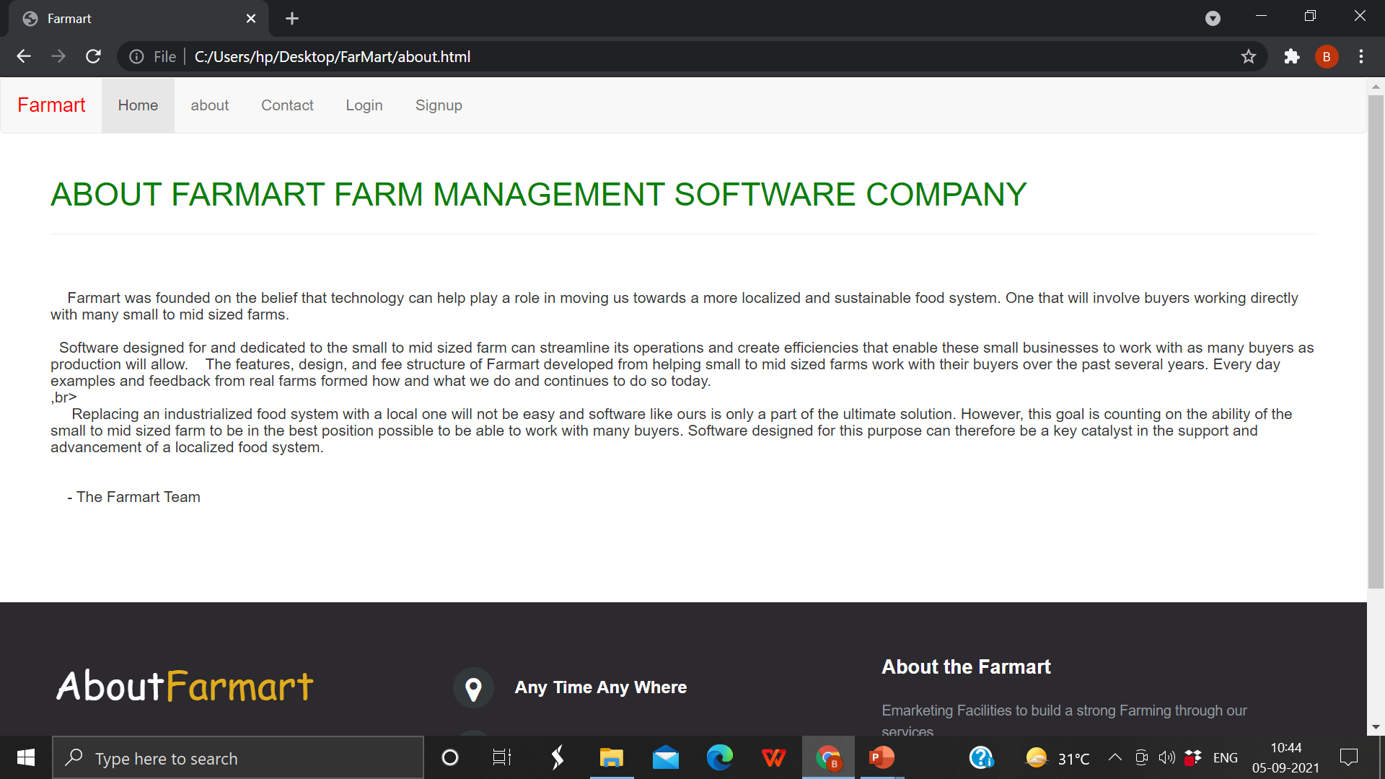
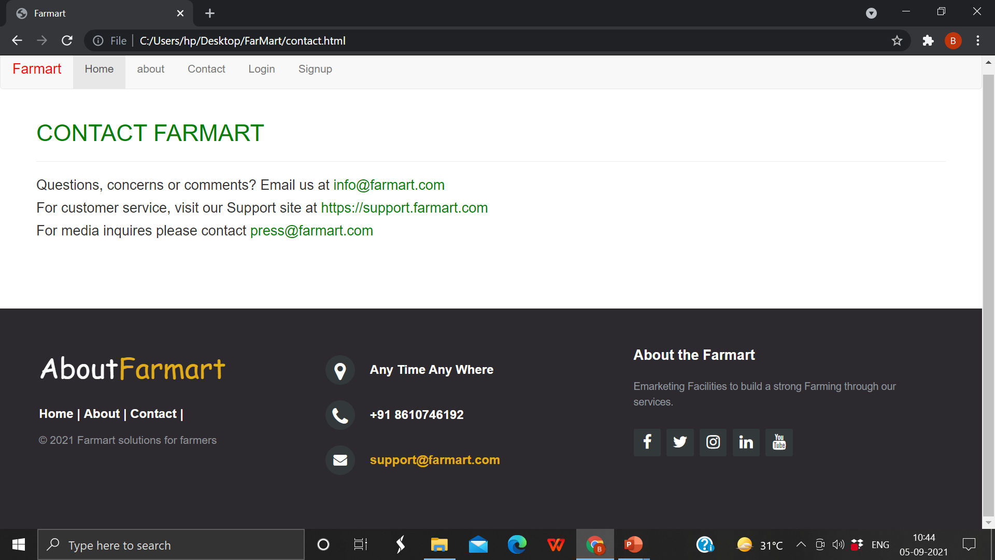

Slide 9
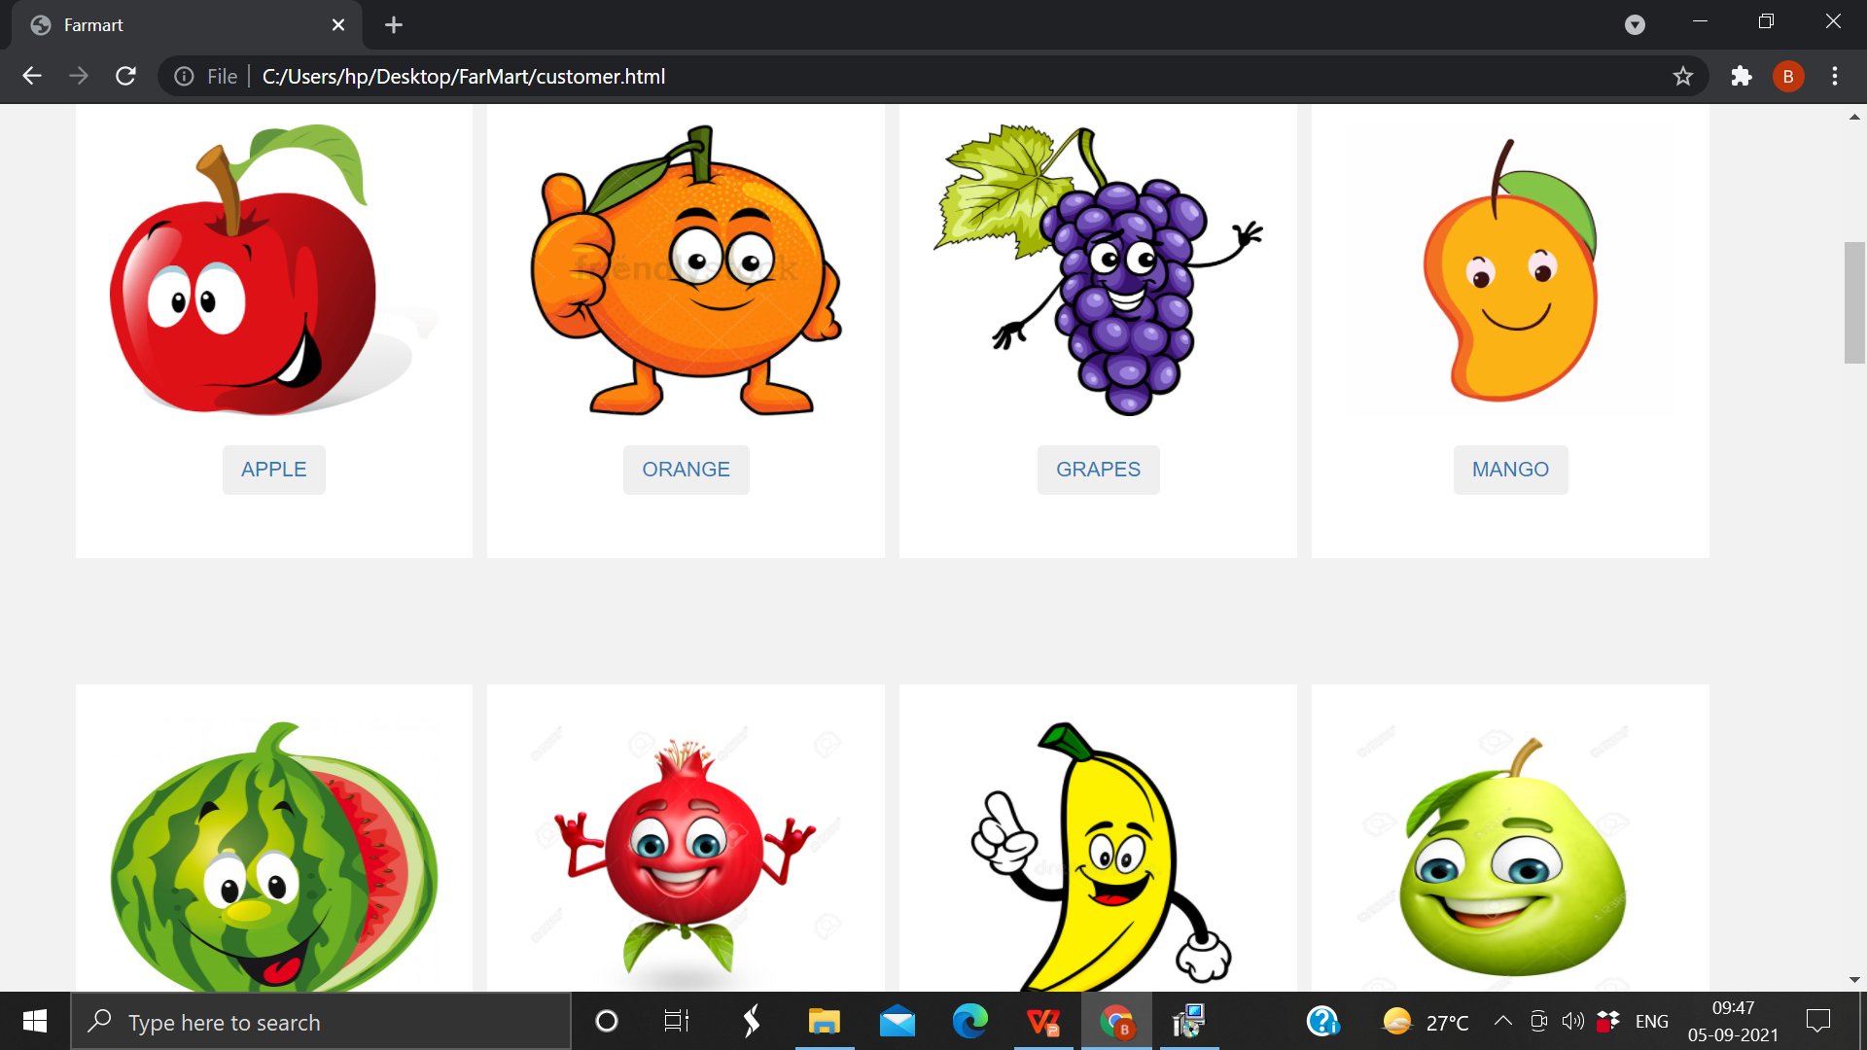
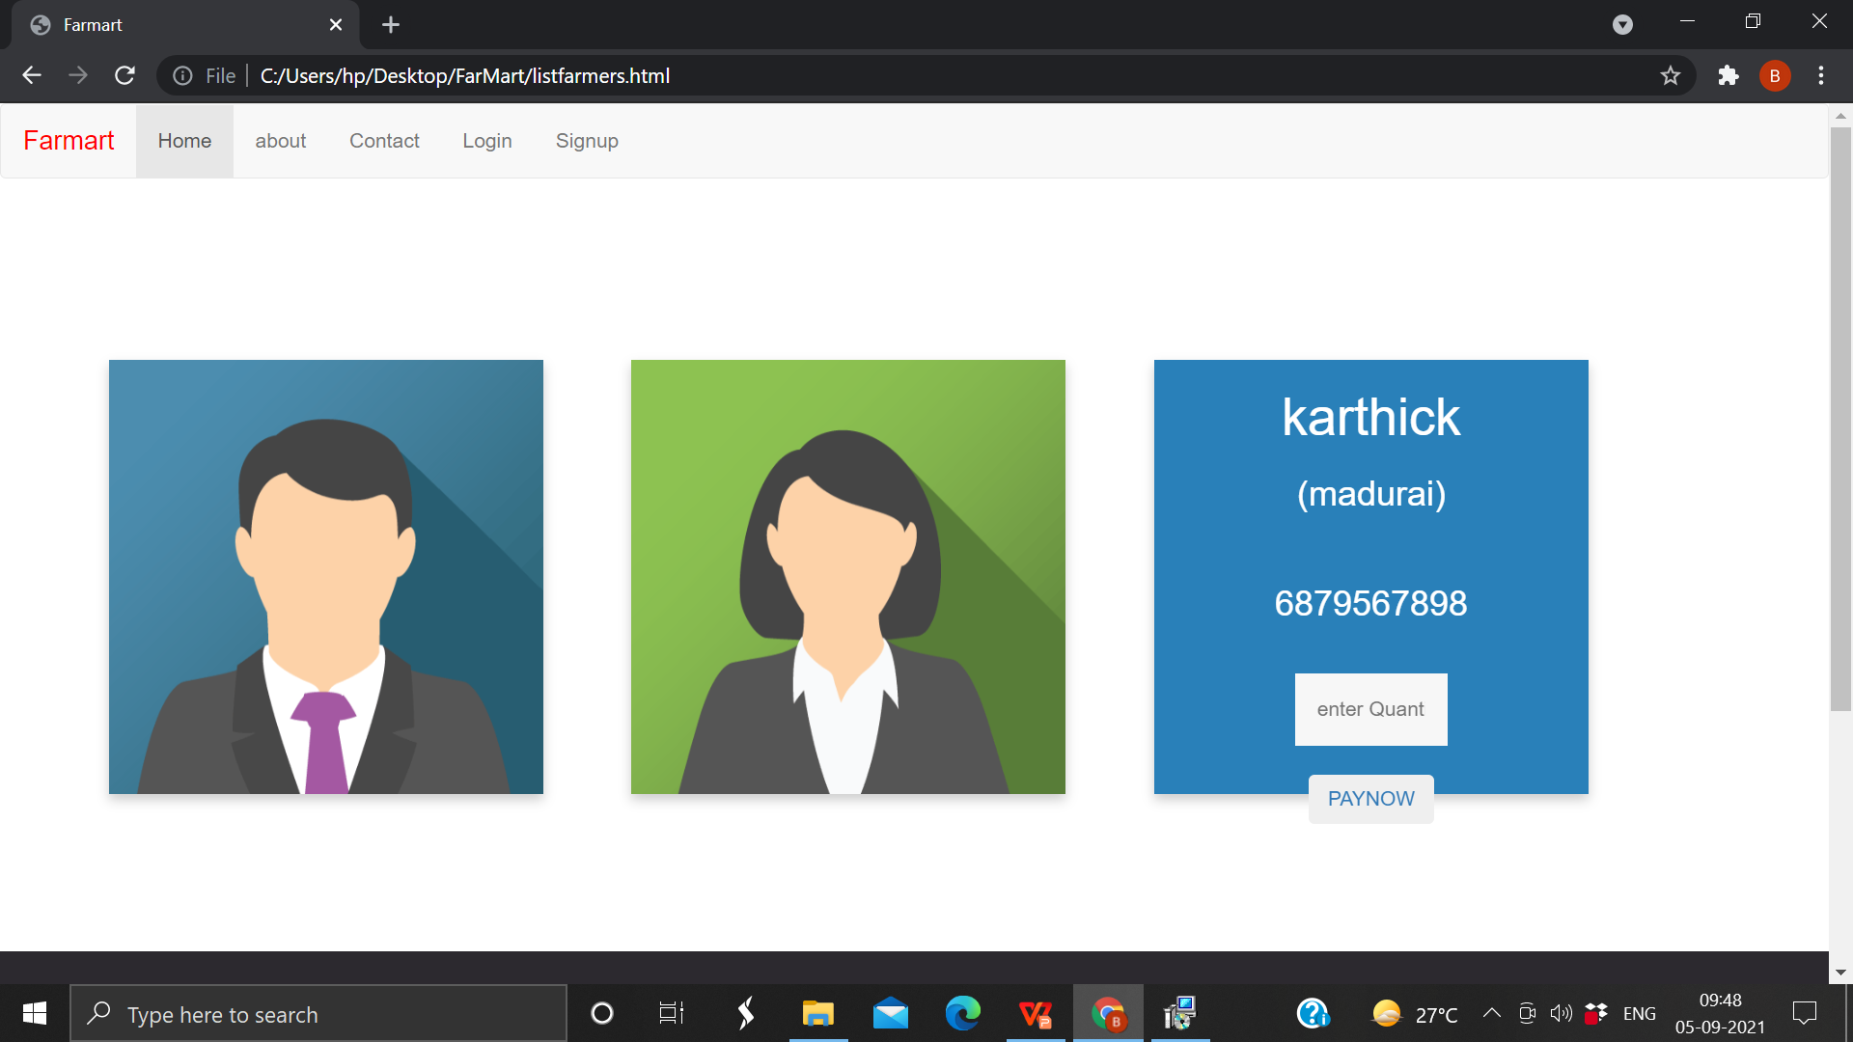

Slide 10
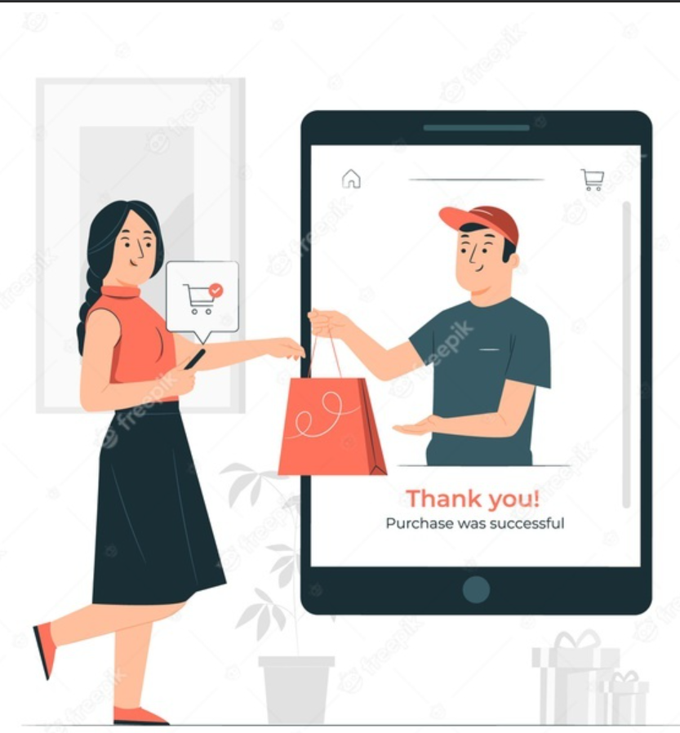
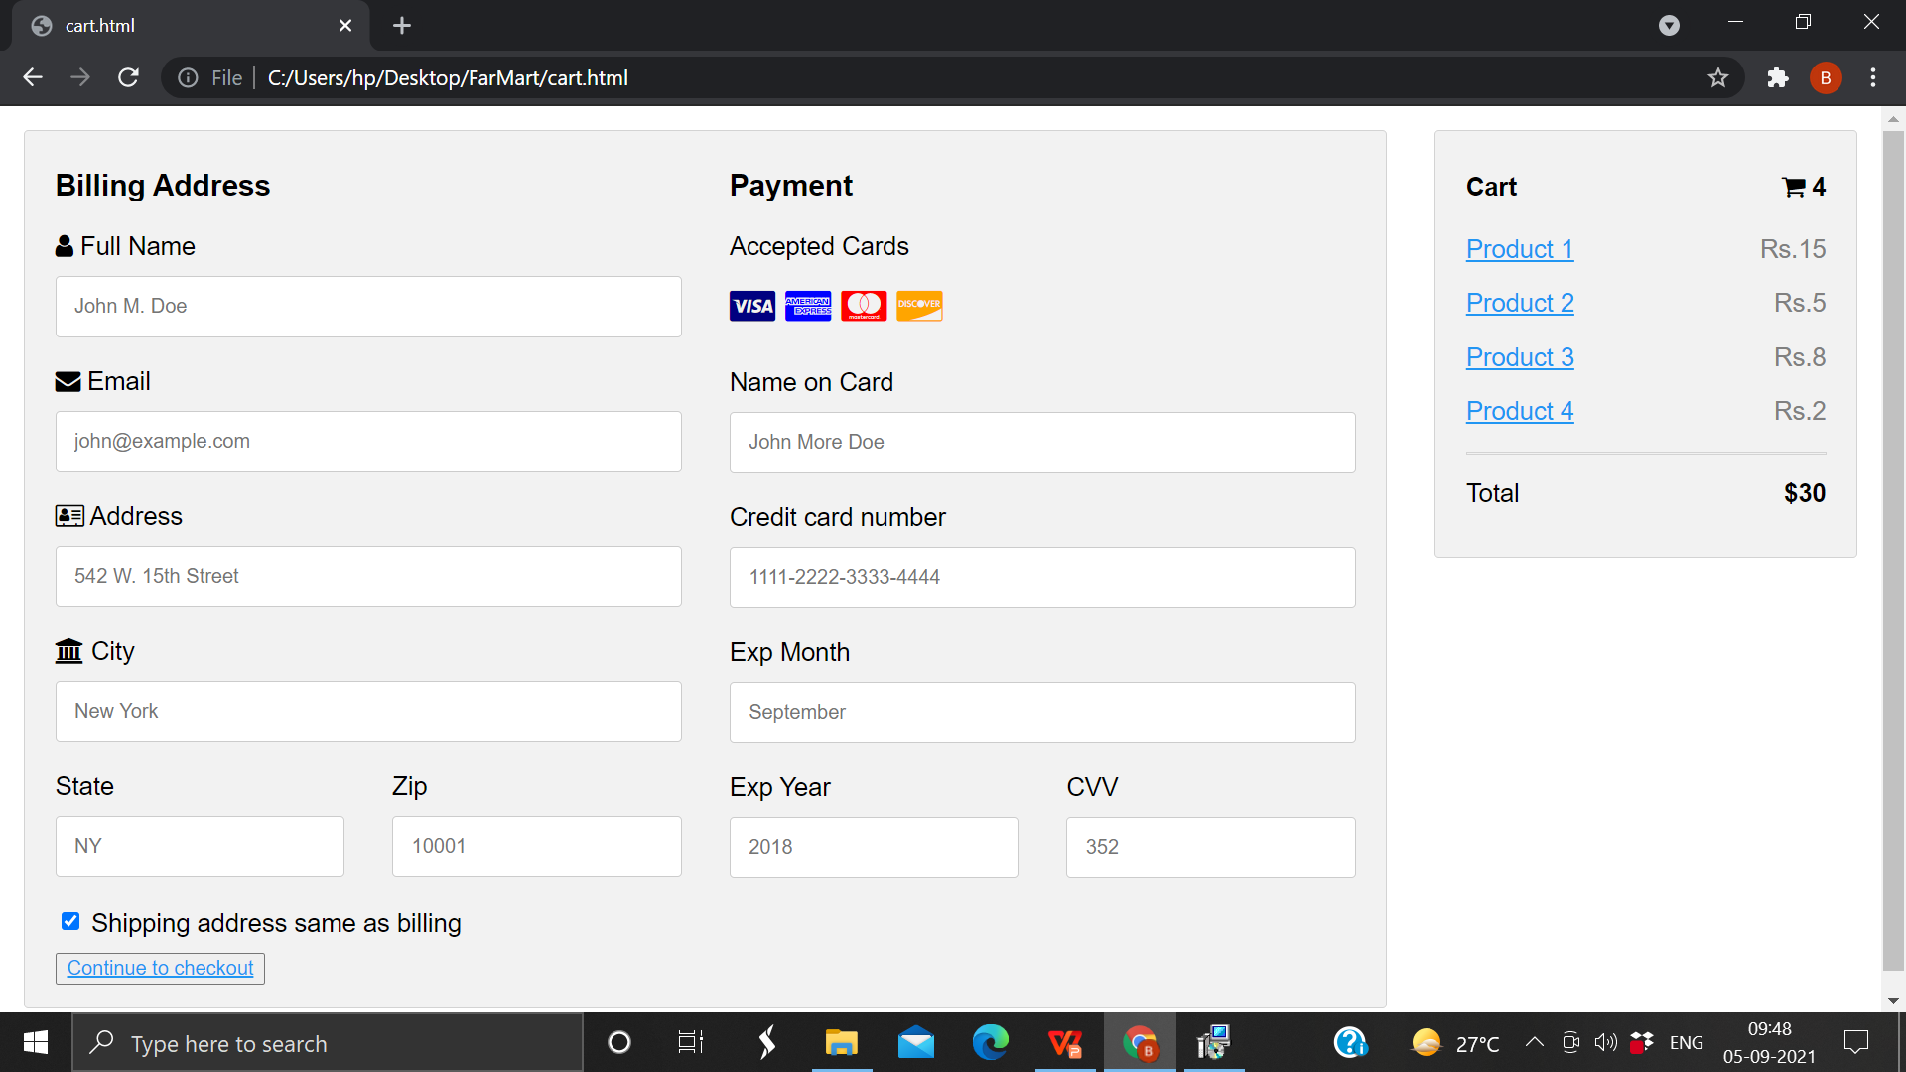

Slide 11
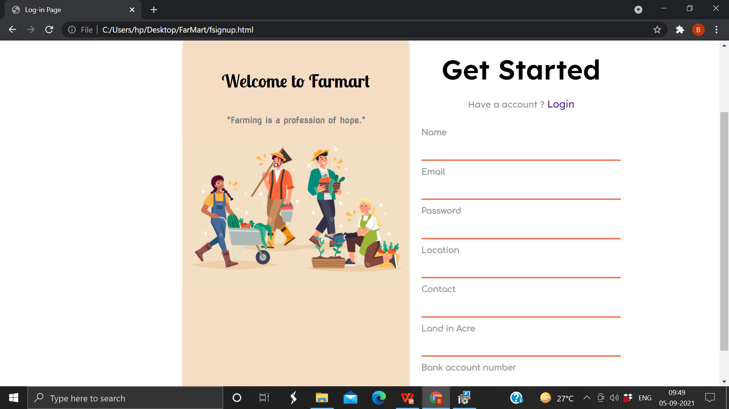
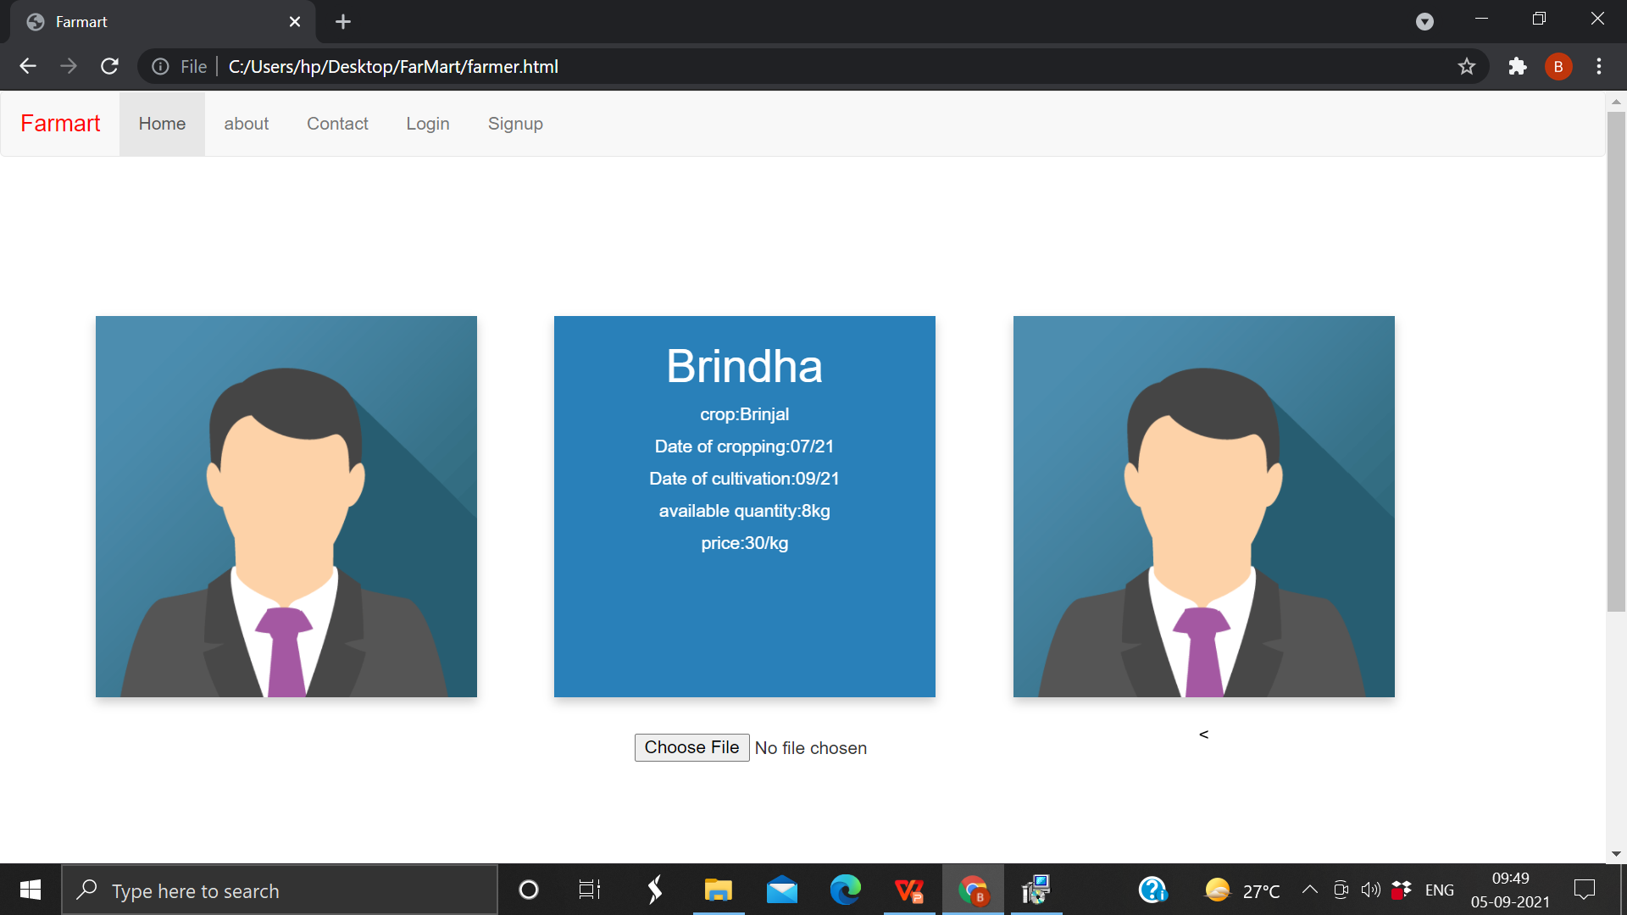
farmers login

Slide 12
Thankyou

